Slide 1

CoC Structure & Purpose
4 CoCs in Wisconsin
Dane County, Milwaukee County, Racine County (each 1 county)
WI Balance of State CoC (69 counties)
The mission of the WI Balance of State CoC is to end homelessness by supporting local coalitions throughout Wisconsin.
The Balance of State is comprised of 21 coalitions or members.
“Ending Homelessness” means every community will have a systematic response in place that ensures homelessness is prevented whenever possible, or if it can’t be prevented, it is a rare, brief, and non-recurring experience.
Quickly identify and engage people at risk of and experiencing homelessness.
Intervene to prevent the loss of housing and divert people from entering the homelessness services system.
When homelessness does occur, provide immediate access to shelter and crisis services, without barriers to entry, while permanent stable housing and appropriate supports are being secured, and quickly connect people to housing assistance and services—tailored to their unique needs and strengths—to help them achieve and maintain stable housing.

Slide 2
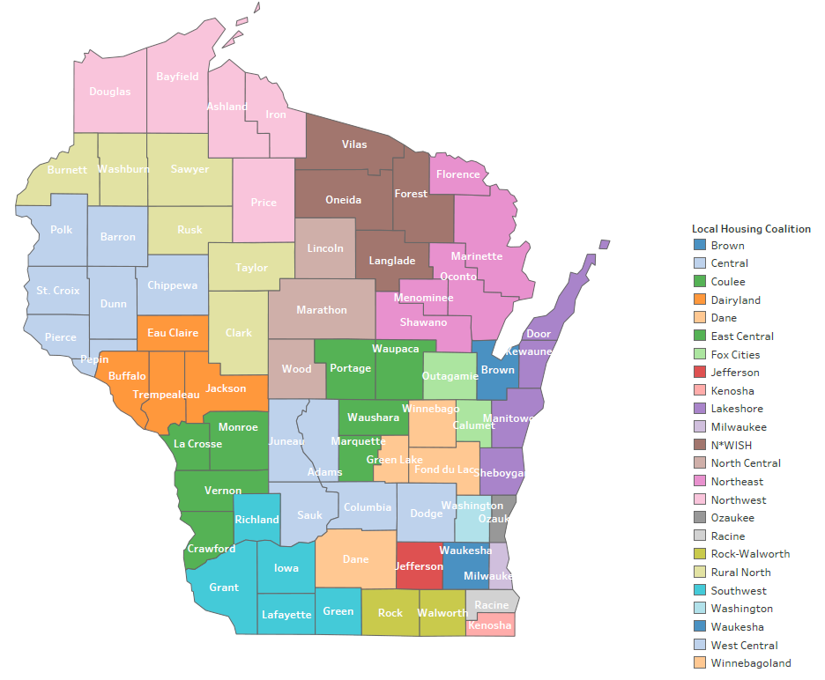

Slide 3
Common terms:
  HUD Definition of homelessness: At a Glance_Criteria and Recordkeeping Requirements for Definition of Homeless (hudexchange.info)
Definition of Homelessness under the McKinney-Vento Homeless Assistance Act
  The McKinney-Vento Homeless Assistance Act defines homeless children and youths as those who lack a fixed, regular, and adequate nighttime residence. The law provides several examples of situations that meet the definition. This includes children and youths:
  sharing housing due to a loss of housing, economic hardship, or a similar reason;
  living in hotels, motels, trailer parks, or camping grounds due to a lack of alternative adequate housing;
  living in emergency or transitional shelters;
  abandoned in hospitals;
  living in a public or private place not designated for, or normally used as, a regular sleeping accommodation for human beings;
  living in cars, parks, public spaces, abandoned buildings, substandard housing, bus or train stations, or similar places; and/or
  living in one of the above circumstances and who are migratory.

Slide 4
Common terms:
  What do we mean by “ending homelessness”?
  An end to homelessness means that every community will have a comprehensive response in place that ensures homelessness is prevented whenever possible, or if it can't be prevented, it is a rare, brief, and one-time experience
  HUD allowable sub populations:
  1. Adults accompanied by children
  2. Adults without children
  3. Unaccompanied youth (age 24 and under)
  4. Households fleeing, or attempting to flee, domestic violence, dating violence, sexual assault, stalking, or other dangerous or life-threatening conditions (including human trafficking)
  5. Veterans

Slide 5
What is Housing First?
Housing First is an approach to quickly and successfully connect individuals and families experiencing homelessness to permanent housing without preconditions and barriers to entry, such as sobriety, treatment or service participation requirements. Supportive services are offered to maximize housing stability and prevent returns to homelessness as opposed to addressing predetermined treatment goals prior to permanent housing entry

Slide 6
What do you already know?
Other than the statements just read, what more do you know about Housing First?
Housing First has been shown to:
  increase housing stability;
  improve quality of life, and improve health and addiction outcomes;
  reduce involvement with police and the justice system;
  reduce costs associated with justice system and health expenditures; and
  reduce hospitalization and emergency visits.
Housing First is a program model, a systems approach, as well as a philosophy.

Slide 7
HOMELESS CRISIS RESPONSE SYSTEM
What is a system?
Many parts
Doing different things
Working together
Toward a common goal
Parts of the Homeless Crisis Response System
There are 8 key components of the system. How much of each (including staff and money) depends on the needs within the community.
Prevention
Outreach
Intake & Assessment
Diversion
Emergency Services
Supportive Services
Transitional Housing
Permanent Housing (Rapid Re-housing and Permanent Supportive Housing)

Slide 8
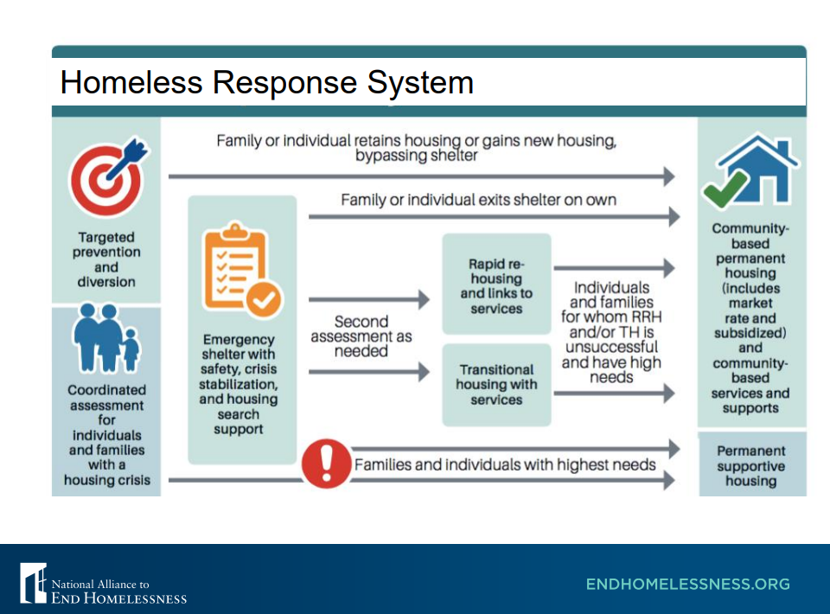
Chronicity

Slide 9
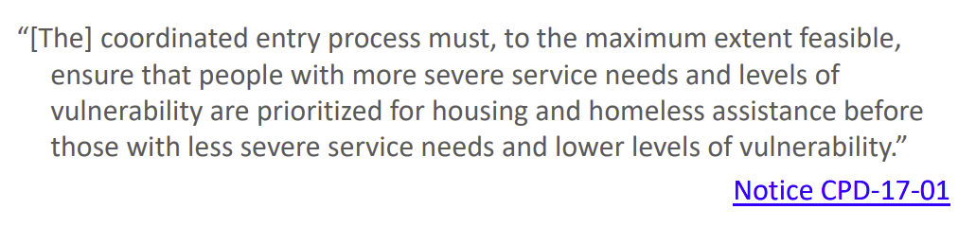
What is Coordinated Entry?
Coordinated Entry is essentially a triage system.
Vulnerability – the likelihood that someone who is homeless may die or be victimized because of their homelessness.
https://www.wiboscoc.org/coordinated-entry.html
Vulnerability – the likelihood that someone who is homeless may die or be victimized because of their homelessness.

Slide 10
Coordinated Entry is NOT:
A specific tool
One agency’s responsibility
About putting an agency’s clients into an agency’s program
A fix for lack of resources
Static
CE is NOT a task to be completed, it IS a process to be managed

Slide 11
What was it is like prior to Coordinated Entry?
The person served was often:
  The person who was in the “right spot at the right time” for the housing program
  The person who was best at advocating for themselves
  The person agencies thought “deserved” the housing program
  The person agencies thought would be “successful” in the housing program
  And so on. The lack of a systematic, nonbiased approach to who we served
Who were we often missing?
  Those who were not actively seeking services
  Those with high service needs
  Those feeling or attempting to flee domestic violence, youth, folks with disabilities.

Slide 12
Housing programs through Coordinated Entry:
(All are “Housing First” projects)
US Dept of Housing and Urban Development (HUD) Continuum of Care (CoC) funded housing programs:
CoC Rapid Rehousing (RRH)
CoC DV Rapid Rehousing (DV RRH)
CoC Permanent Supportive Housing (PSH)
CoC Transitional Housing (TH)
CoC Youth Homeless Demonstration Project Housing (YHDP)
State EHH Funding (Federal Emergency Solutions Grant (ESG) + Housing Assistance Program (HAP) + Homeless Prevention Program (HPP) = EHH) and other housing programs:
EHH Rapid Rehousing (RRH)
EHH Homeless Prevention
Family Unification Program (FUP)
HOME ARP

Slide 13
CoC Funded Housing Programs:
CoC Rapid Rehousing (RRH)
  Up to 2 years of rental assistance with regular case management
  Goal is to be able to stay in the unit and self sufficiency
CoC DV Rapid Rehousing (DV RRH)
  Same as CoC RRH, but only serves survivors
CoC Permanent Supportive Housing (PSH)
  Serves Chronically Homeless (*Chronicity = disability + 4 homeless episodes in 3 year OR 12 or more months of continues homelessness)
  Lease is in the Agencies name, and provides indefinite rental assistance and intensive case management
  Move on strategies

Slide 14
State EHH Funding (Federal Emergency Solutions Grant (ESG) + Housing Assistance Program (HAP) + Homeless Prevention Program (HPP) = EHH) and other housing programs:
EHH Rapid Rehousing (RRH)
  Shorter term rental assistance with less intensive case management
EHH Homeless Prevention
  Serves Imminently homeless (homeless in 14 days or less) and At risk of homelessness
  Prioritizes imminently homeless first
Family Unification Program (FUP)
  Eligibility determined by the PCWA
  Prioritizes HUD category 1 and 4 first

Slide 15
Your Role in Coordinated Entry:
Assist clients in filling out the Pre-screen form
Assist clients in understanding the Client Rights and Responsibilities form
WI BOS barriers assessment
Follow up
Respond quickly to housing projects looking to house your clients

Slide 16
Top 5 Things Needed to End Homelessness
Strong Coalition
Diverse perspectives including people with lived experience
Focused on ending homelessness, not managing it
Willing to be creative and focused on needs of the population
Strong Homeless Crisis Response System
Ensure that the system includes: prevention, diversion, outreach, intake & assessment, emergency services, housing solutions, and case management
How much of each service is needed, what performance is expected, what outcomes are reached, what can be improved?
Enhance coordinated entry system to ensure all people experiencing homelessness have access to prioritization list referral
Commitment to Ending Homelessness
Case conferencing, problem solving, and seeking permanent housing solutions for everyone identified as homeless
Enhanced case management with team approach across sectors (including mental health and addiction services & supports), using housing first philosophy, being client centered and trauma informed
Focus on reducing inflow into the system and increasing outflow with positive client outcomes
Active participation in strategic planning and solutions

Slide 17
Top 5 Things Needed to End Homelessness
Affordable Housing
Must have places for people to live
Landlords of Existing Properties
Willing to work with people who are seeking to end their homelessness
Units must be affordable (below 60% County Median Income, focus on 0-30% County Median Income)
Units must be accessible and meet basic housing quality standards (safe and sanitary)
Units must be rent reasonable and within fair market rent (program specific requirements) for the community
Issues with credit or no credit
Negative rental history or no rental history
Criminal background
Willing to accept housing vouchers
Willing to make necessary repairs to bring units into compliance with basic housing quality standards

Slide 18

QUESTIONS?
Ryan Graham: ryan.graham@wibos.org

Slide 19
Contact Information
  Ryan Graham
  Coordinated Entry Systems Specialist
  Wisconsin Balance of State CoC
  ryan.graham@wibos.org
  PO Box 272, Eau Claire, WI 54702
  Phone: 715-225-0164
  Website: www.wiboscoc.org

